Slide 1
“AUDIENCE ANALYSIS”
Technical Business Writing
Department of Computer Science

Slide 2
AUDIENCE RECOGNITION
In the business world you will never speak in vacuum. Consider the following questions:
  Who is your audience?
  What does this reader or listener know?
  What does this reader or listener not know?
  What must you write or say to ensure that your audience understands your purpose?
  How must you communicate to more than one person(multiple audience)?
  What is the person’s position in relation to your job title?
  What is the person’s attitude toward your topic?
  What diversity issues you must consider?

Slide 3
If you do not know the answer to the previous questions then your document may:
  Contain jargon or acronyms your reader will not understand
  Have tone that may be inappropriate for management(too dictatorial) or for the subordinates(too relaxed)
  Not consider your audience’s level of understanding
  Not factor in your audience’s unique personality and traits, which could impact how successfully you communicate

Slide 4
KNOWLEDGE OF SUBJECT MATTER
What does you audience know about the subject matter?
Does the person work closely with you on the topic?(High-tech peers)
Does the audience have general knowledge of the subject matter but a different area of expertise?(Low-tech peers)
Is the audience totally uninvolved in the subject matter?(Lay audience)
Could your audience be a combination of the above?(Multiple audience)

Slide 5
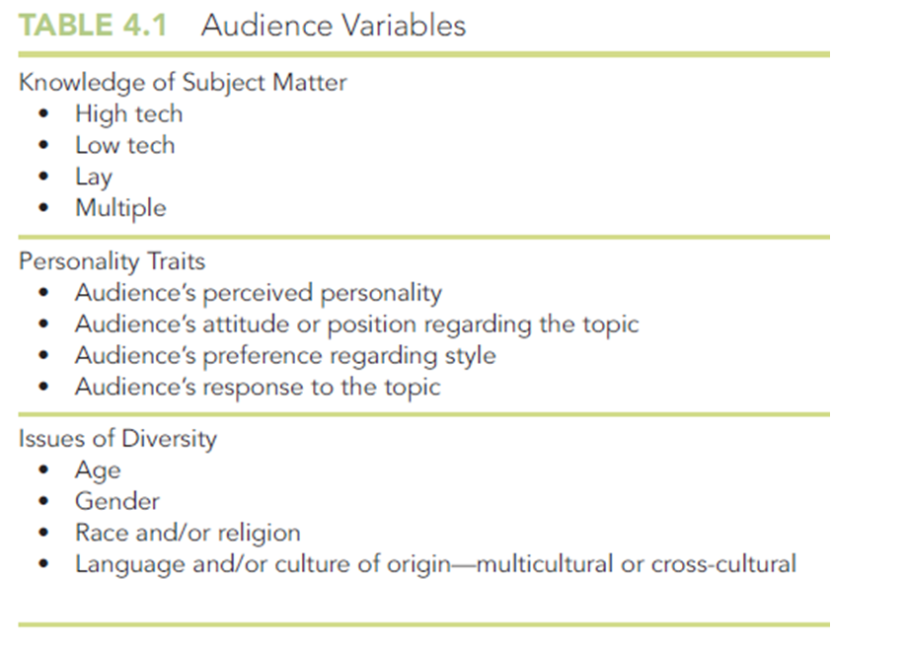

Slide 6
1-HIGH TECH AUDIENCE
Working in your field
Might work directly with you in your department
Might work in a similar capacity for another department
Wherever they work, they are your colleagues because they share your educational background, work experience, or level of understanding.
If you are a computer programmer, for example, another computer programmer working on the same system is your high-tech peer.

Slide 7
CHARACTERISTICS OF HIGH-TECH AUDIENCE
Experts in the field you are writing about.
  If you write an email to a department colleague about a project you two are working on, your associate is a high-tech peer.
They share your level of understanding because their experience and qualification is comparable to yours:
  They will understand high-tech jargon, acronyms, and abbreviations. You do not need to explain MHz to an electronic technician.

Slide 8
They require minimal details regarding standard procedures or scientific, mathematical, or technical theories:
  Two biomedical technologists, when discussing pH, do not need to explain what pH is.
They need little background information regarding a project’s history or objectives unless the specific subject matter of the correspondence is new to them:
  For example, if you are writing a status report to your supervisor, who has been involved in the project since its conception, you will not need to mention the history of that project unless the supervisor is new.

Slide 9
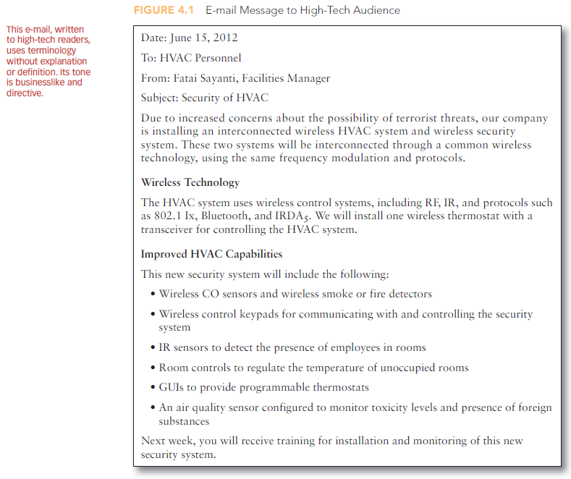

Slide 10
LOW-TECH AUDIENCE
Your coworkers in other departments
Might include your bosses, subordinates, or colleagues who work for other companies.
For example, if you are a biomedical equipment technician, the accountant or personnel director or graphic designer in your company are your low tech-peers. They have worked around your company’s equipment and, therefore, are familiar with your technology. However, they do not understand the intricacies of this technology.
Your boss is often low-tech because he no longer works closely with the equipment. Although they were technicians at one time, as they moved into management, they moved further and further away from technology.

Slide 11
Your subordinate might be low-tech because their level of experience and education is less than yours.
Although your colleagues at other companies might have your level of education and work experience, they could be low-tech if they are not familiar with your company's procedures or in-house jargon, acronyms, and abbreviation.

Slide 12
CHARACTERISTICS OF LOW-TECH AUDIENCE
Familiar with the technology but their job responsibilities are peripheral to the subject matter.
Since they are familiar with your subject matter, they understand some abbreviations, jargon, and technical concepts. To make sure they understand your content, define the abbreviation parenthetically: BCA (burst cutting area).
You need to provide some background information.

Slide 13
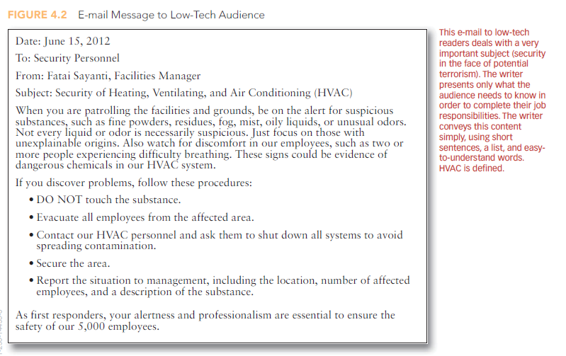

Slide 14
3. LAY AUDIENCE
They don’t work with you or for your company
Have no knowledge about your field
If you work in network communications for a cable company, for example, and you write an email to a client regarding problem with the high-speed internet connection, your audience is lay reader.

Slide 15
HOW TO WRITE SUCCESSFULLY TO LAY AUDIENCE
Write in a simple and easy to understand manner as they do not have knowledge of the subject matter. Explain the topic to them through precise word usage, depth of detail, and simple graphics.
Avoid high-tech terms or define them thoroughly as they do not understand your jargons, abbreviation, or acronyms.
Include background information

Slide 16


Slide 17
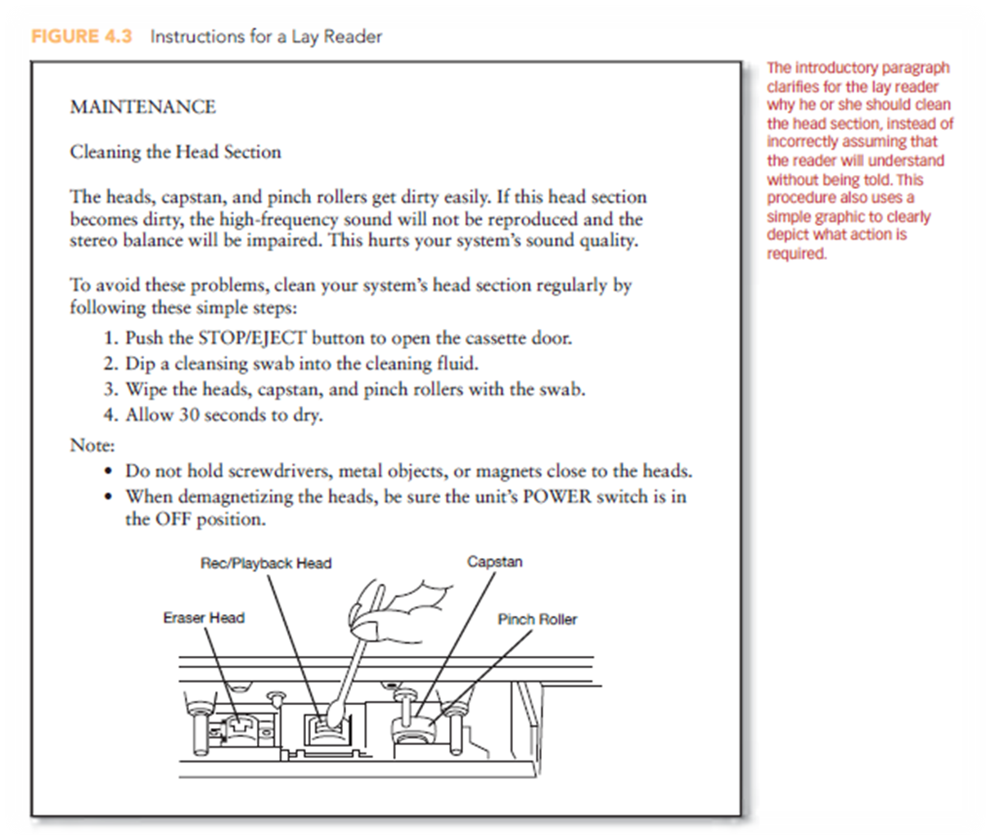

Slide 18
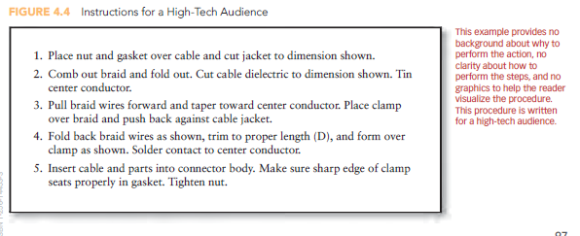

Slide 19
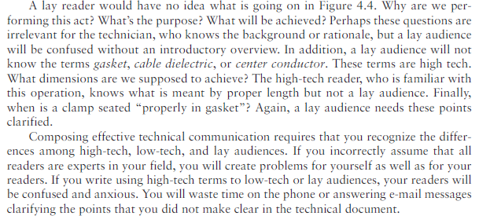

Slide 20
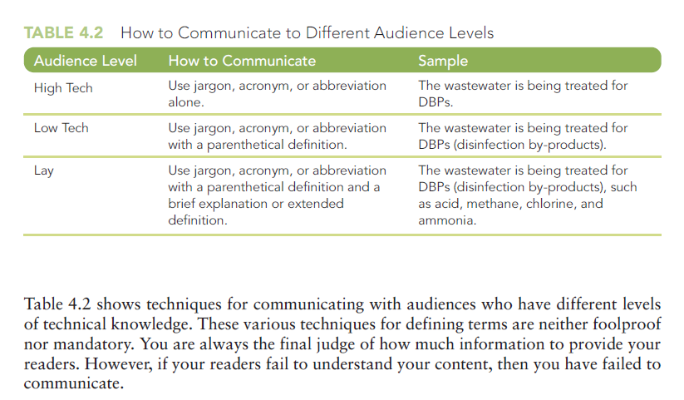

Slide 21
MULTIPLE AUDIENCE
Audience from different level of expertise
For example, when writing a report, most people will assume that their supervisor will be the only reader. The report might be sent to others also.
It is a challenge to cater the needs of multiple audience

Slide 22
CHARACTERISTICS OF MULTIPLE AUDIENCE
Your intended audience may not necessarily be the only audience.
Some of the multiple readers will be unfamiliar with the subject matter. Proper background data (objectives, overviews) will clarify the history of the report for these readers. In a letter, report, e-mail messages, Web site, or blog, this background information cannot be too elaborate. In this case, you can provide a reference line, subject line, or link suggesting where the readers can find out more about the subject matter if they wish– “Reference: Operations Procedure 321 dated 9/12/12.”

Slide 23
In longer reports, background data will appear in the summary or abstract, as well as in the report’s introduction.
Multiple audience have diverse understandings of your technology. This requires that you define jargon, abbreviation, and acronym.

Slide 24
DEFINING TERMS FOR AUDIENCE
The terms for audience can be defined:
  Parenthetically
  In a sentence
  In an extended paragraph
  In a glossary
  As online help with a pop-up definition

Slide 25
DEFINING TERMS PARENTHETICALLY
Rather than just writing CIA, write CIA (cash in advance) or cash in advance (CIA).
These parenthetical definitions are to be used once per correspondence. They do not take a lot of time or offend the readers. If the document includes many jargons, abbreviations, and acronyms, then parenthetical definitions might be difficult to manage. In this case, supply a separate glossary.

Slide 26
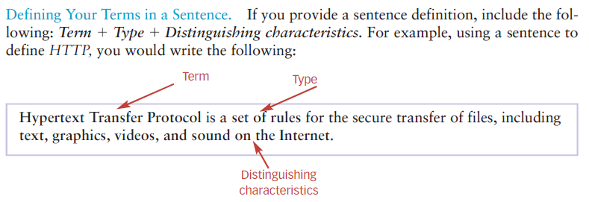
DEFINING TERMS IN A SENTENCE

Slide 27
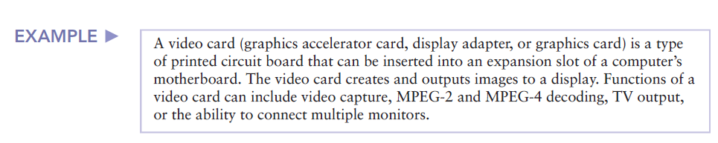
DEFINING TERMS IN AN EXTENDED PARAGRAPH

Slide 28
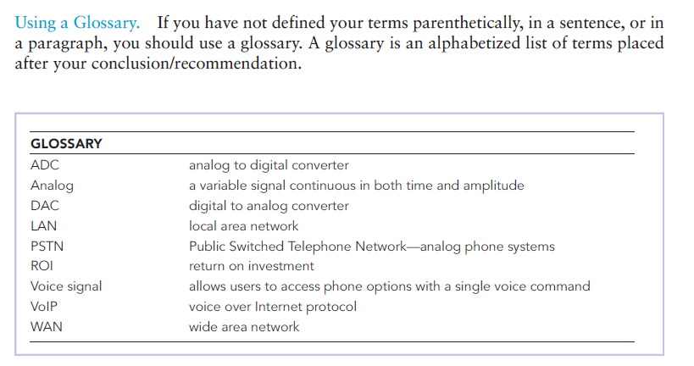
DEFINING TERMS USING A GLOSSARY

Slide 29
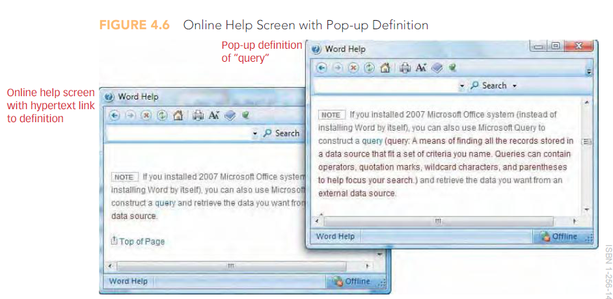
DEFINING TERMS THROUGH ONLINE HELP OR WITH A POP-UP DEFINITION

Slide 30
ISSUES OF DIVERSITY IN COMMUNICATION
Gender
Race
Ethnicity
Religion
Age
Class
Physical and mental characteristics
Language

Slide 31
WHY YOU SHOULD BE CONCERNED ABOUT DIVERSE AUDIENCE
Prejudicial behavior and discrimination on the job will not be tolerated.
Respecting diversity is the right thing to do. People should be treated equally regardless of their age, gender, culture, or religion.
Diversity is good for business.
  A workplace where employees feel valued and respected results in more motivation and commitment to the company.
  Clients and customers prefer shopping in an environment devoid of prejudice.

Slide 32
A diverse workplace keeps companies competitive. Talent does not come in one color, nationality, or belief system. Instead, talent is represented by people from a vast array of background and life experiences. Competitive companies cannot allow discriminatory preferences and practices to impede them from attracting the best talent. Diversity management is such an important concern that American businesses spend millions of dollars training employees to understand multiculturalism and diversity.

Slide 33
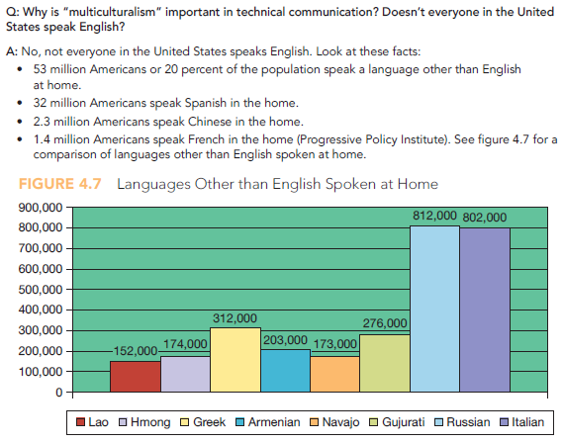
MULTICULTURALISM AND TECHNICAL COMMUNICATION IN A GLOBAL ECONOMY

Slide 34
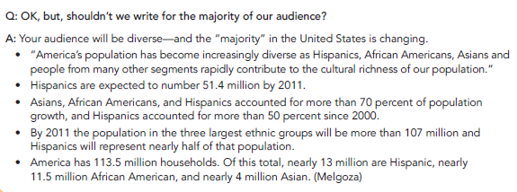

Slide 35
TO DO:
Q1: Write a detailed note on any three challenges faced in multicultural communication. (10)
Q2: Make a Presentation of any of the following
1. Multi Culture
2. Cross Culture
3. Intra Culture
Q3. Use the following terminologies in a sentence where your audience is a layman:
Bit
Cloud
Ethernet

